Slide 1
Synthetic 3D
Improve text-to-3D Generation with Synthetic Data

Slide 2
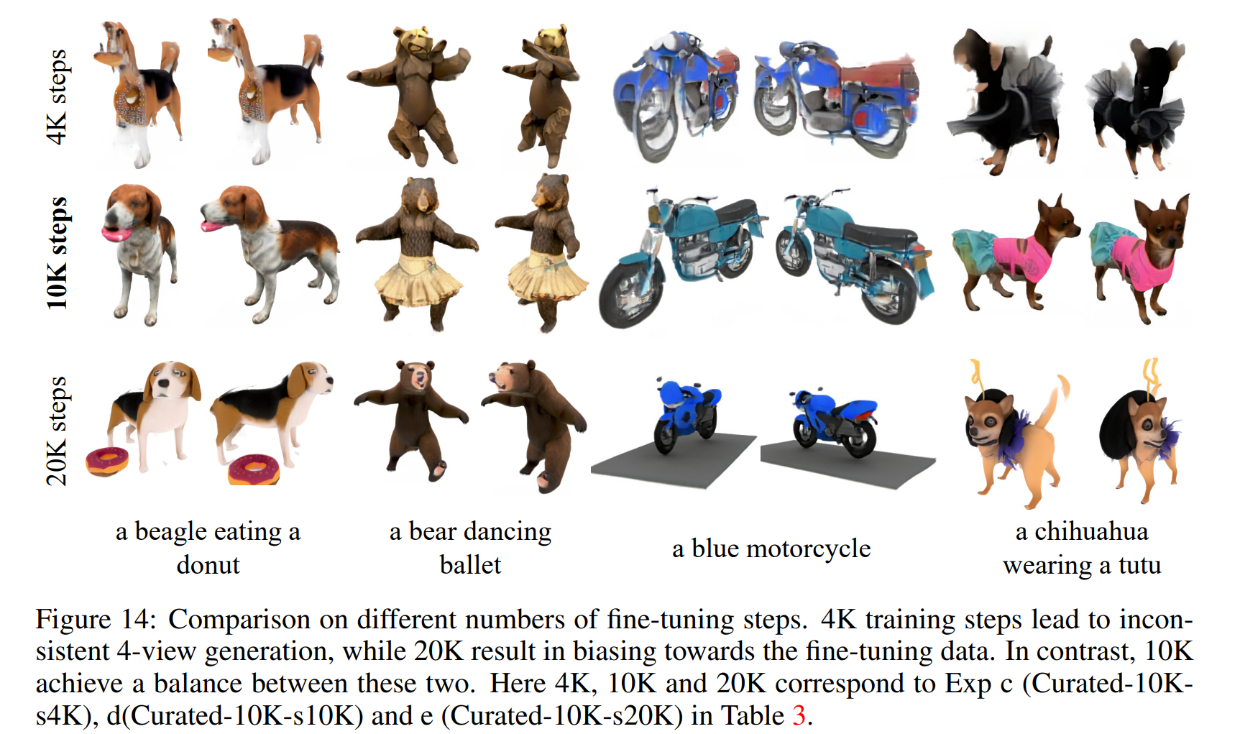
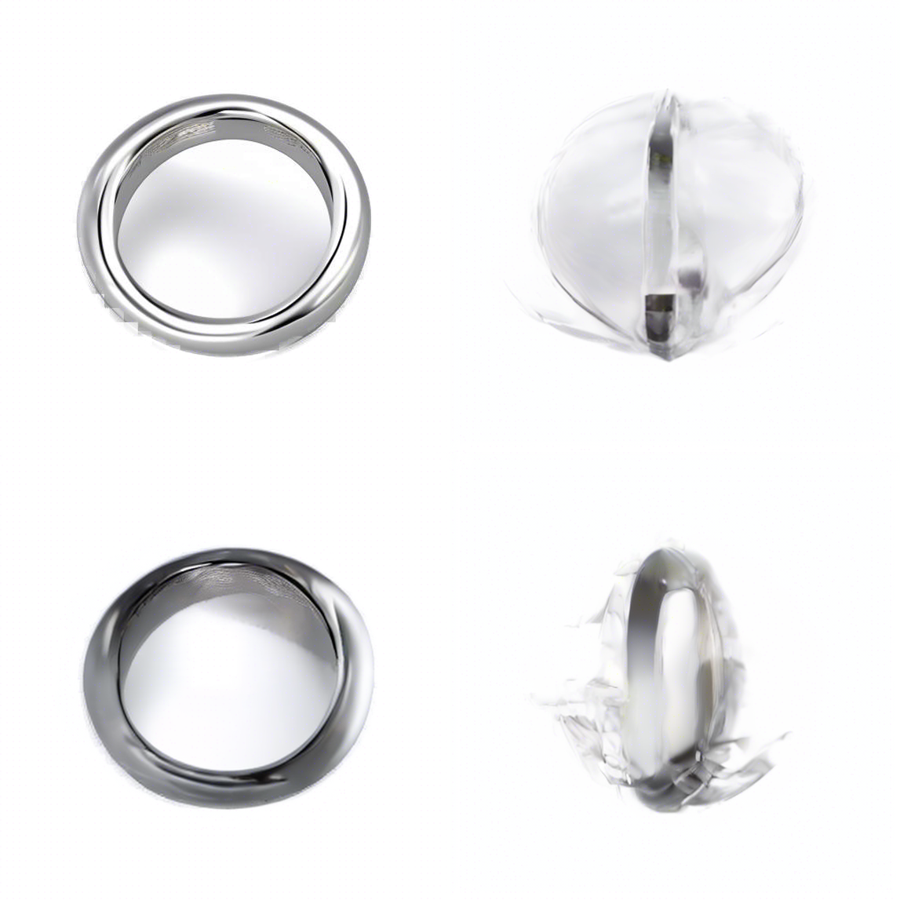
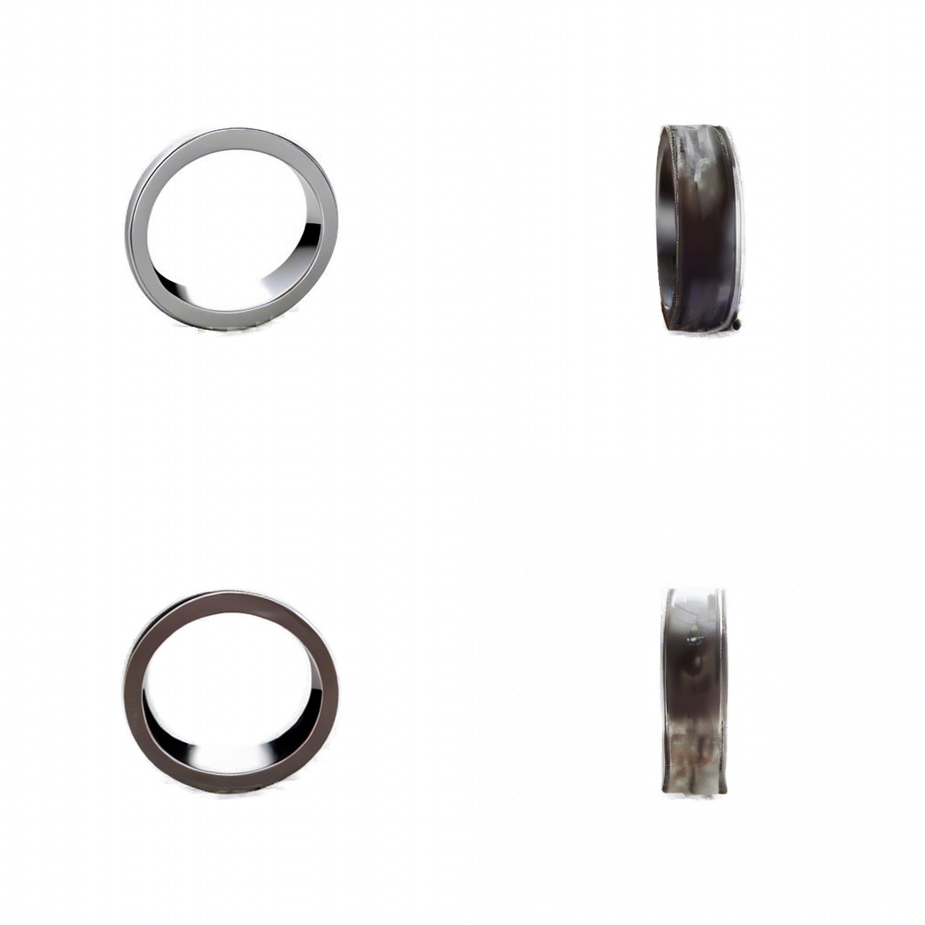
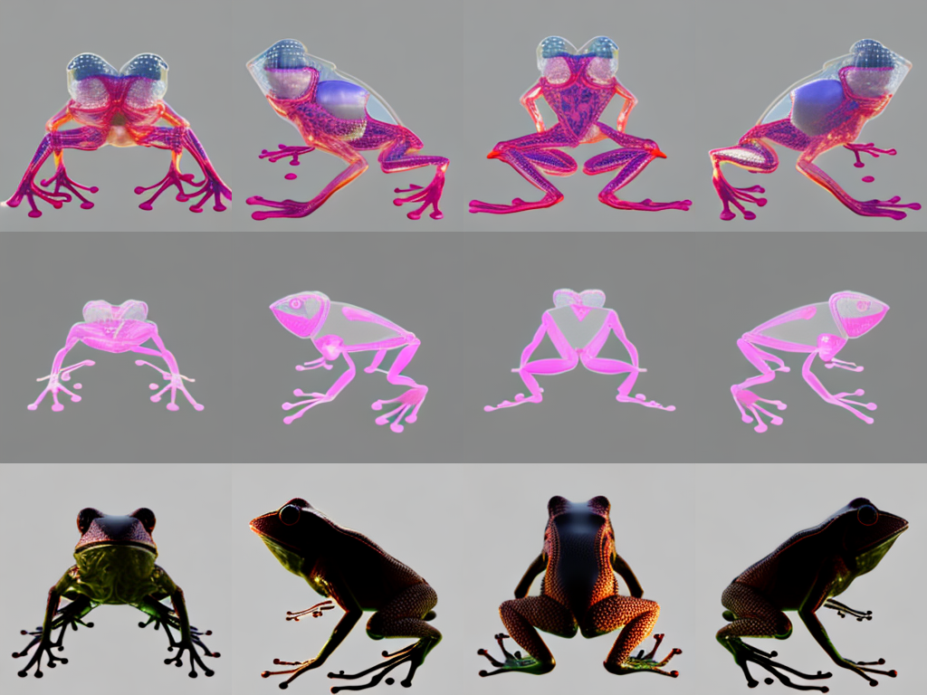
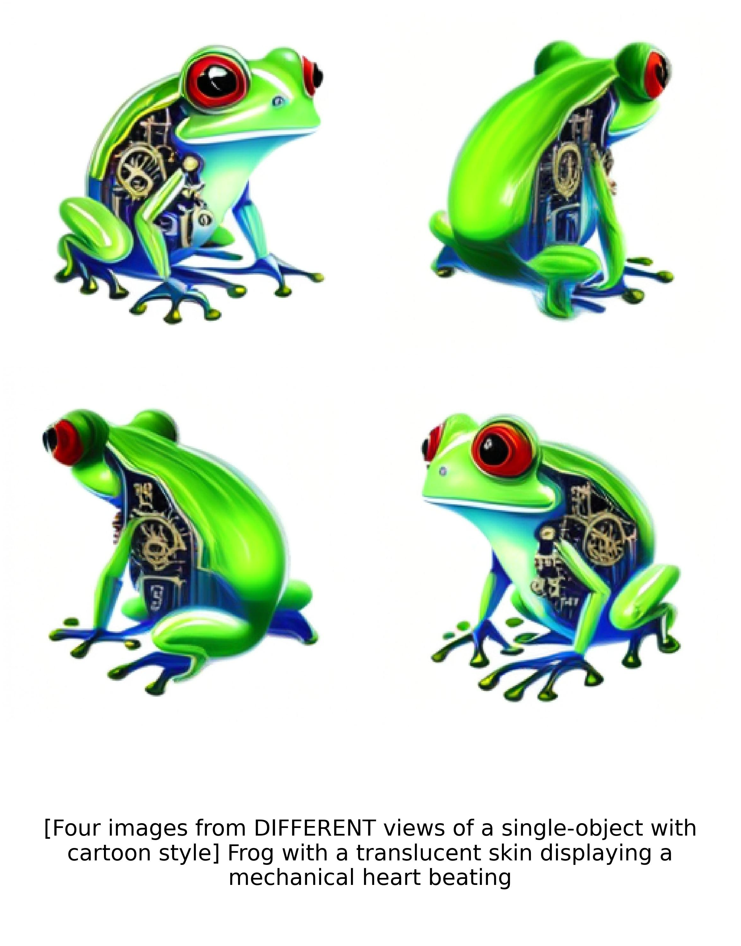
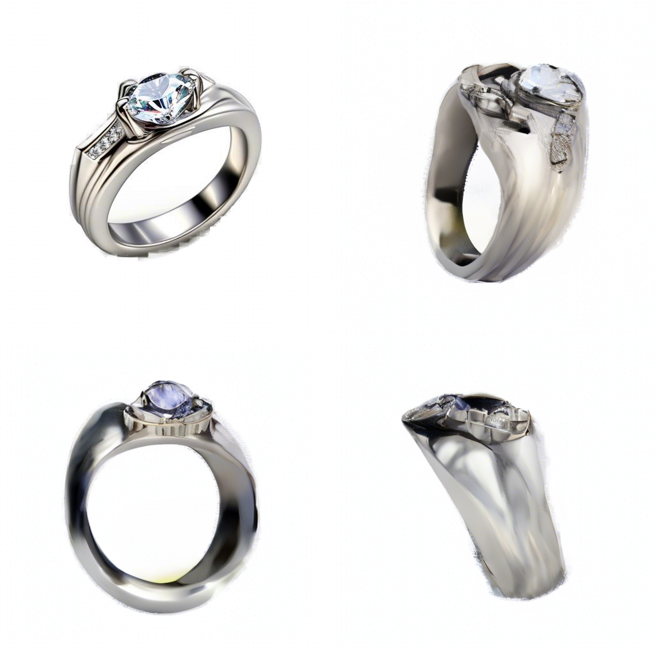
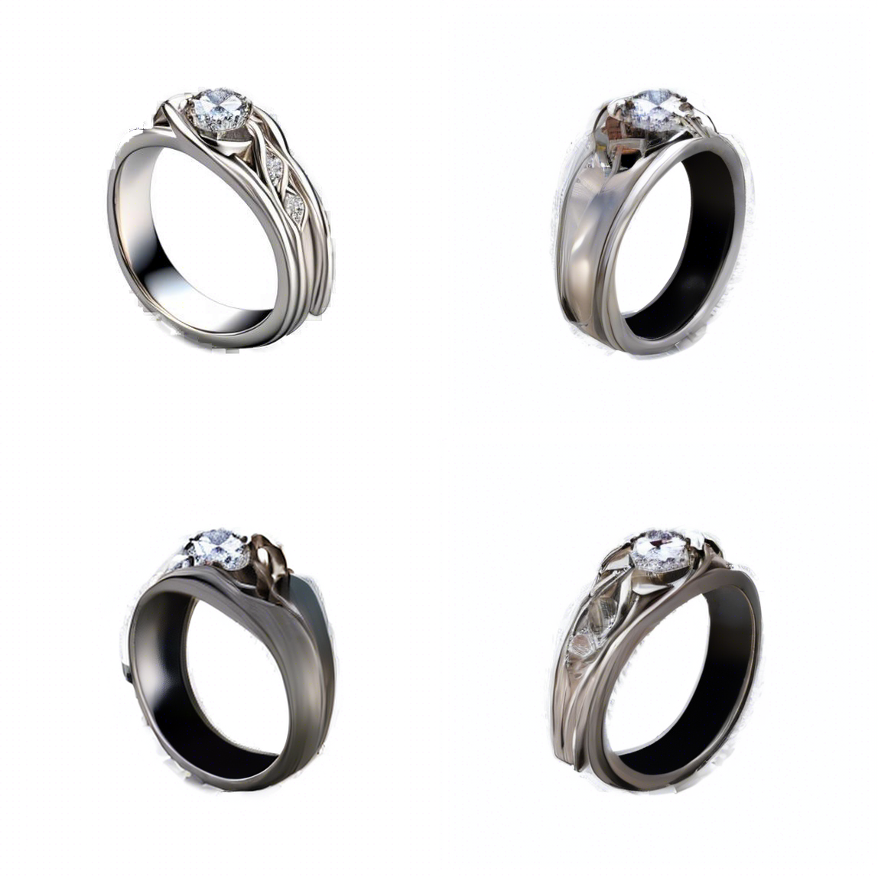
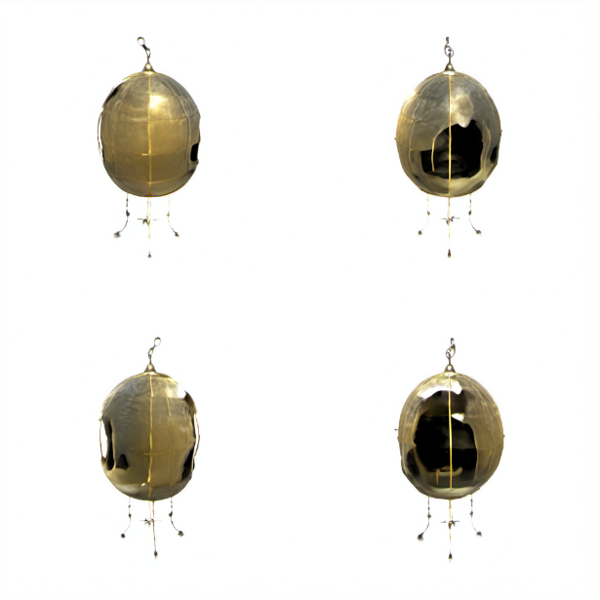
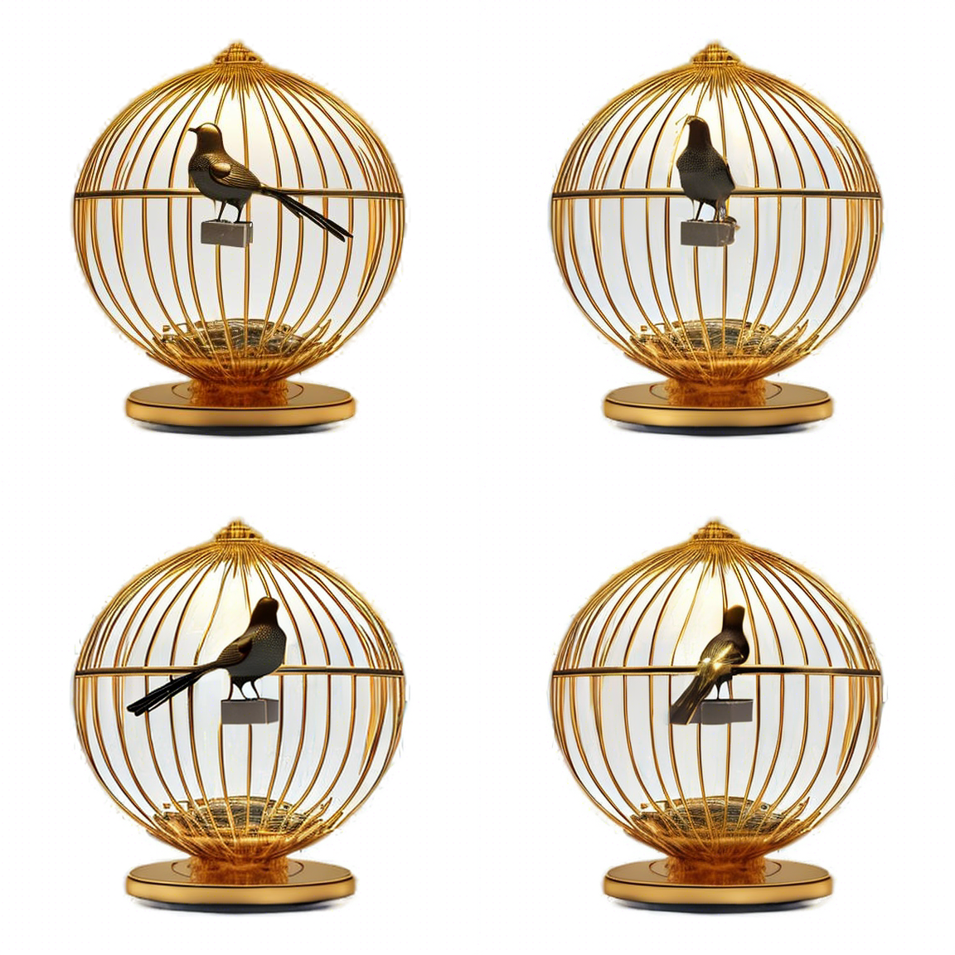
Motivation
2D single view diffusion model are trained on LAION2B, LAION-Asethetic
Almost all Multi-View diffusion model(MVDream, MVDream++, ImageDream, Zero123, Zero123++, Instant3D...) are trained on Objaverse with 800K 3D data.
many of them leave only HQ part of data with 10K-100K
Objaverse-XL is HQ sparse(around 200K HQ data) and hard to access
Take Instant3D for example, using only 10K HQ data for finetuning and training for 192 epoch...
facing Great overfitting(cartoon style) when training longer with more data
SV3D finetuned on SVD to achieve novel view synthesis, suferring motion bluring and darker back view.
MVDream
instant3d

Slide 3
Motivation
借助SV3D构建大量生成数据，通过MLLM筛选出高质量的数据并进行capton标注，尝试一些技巧利用2D-diffusion model能够生成极高质量的图片的先验，并在训练过程中尽量不破坏这些先验
Contribution
1. A MV-Diffusion model可以更好地follow text prompt并且生成风格可定制的更高质量的multiv-view image，这个模型可以结合Large Reconstraction Model快速生成3D物体
2. 合成的大规模multi-view image数据集，只保留较高质量的，并配以caption(包括给Objaverse的物体加上caption)
3. 一种结合合成数据和2D真实数据以及真实3D数据的training balance方案，在训练过程中较好保留single image diffusion model 的先验(缓解训练导致的catestrophic forgetting的问题)

Slide 4
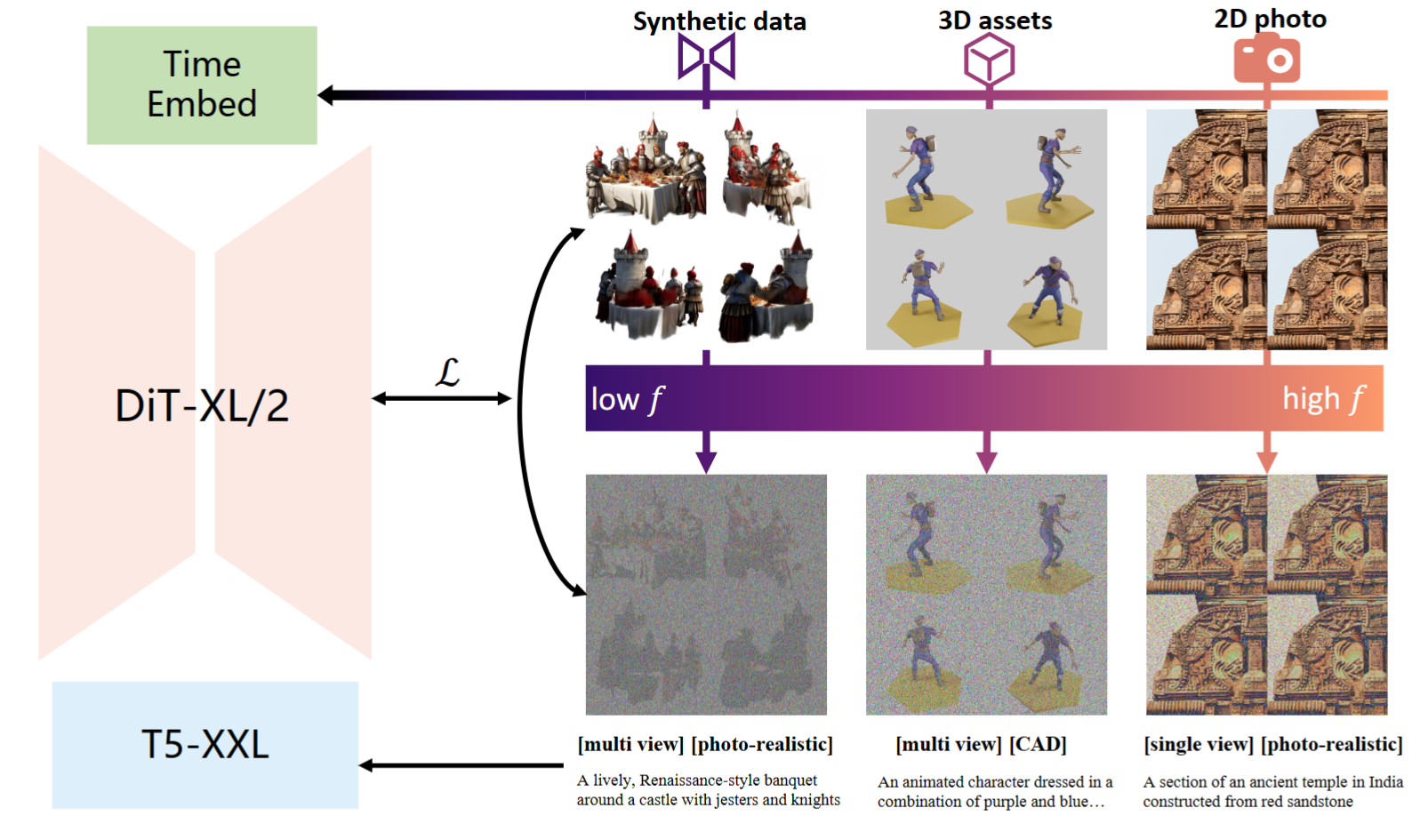
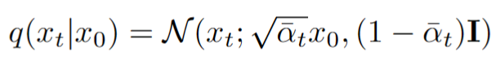
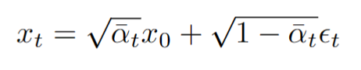
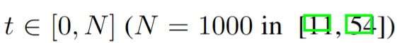
Methods [Training Noise Reschedule]

Slide 5
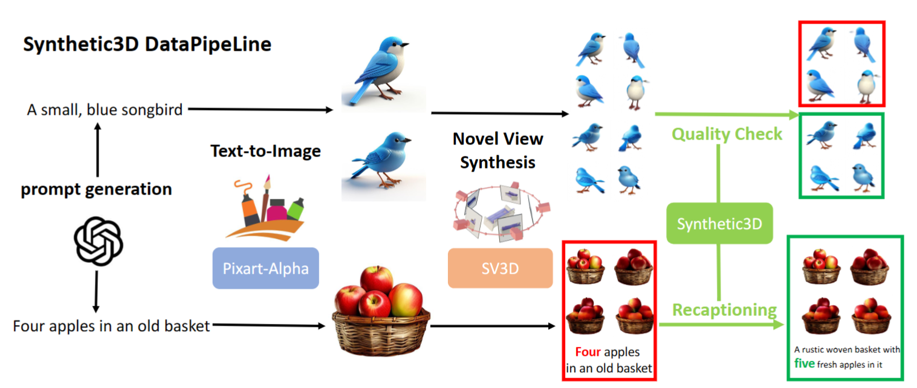
Methods [Data Generation Pipeline]

Slide 6
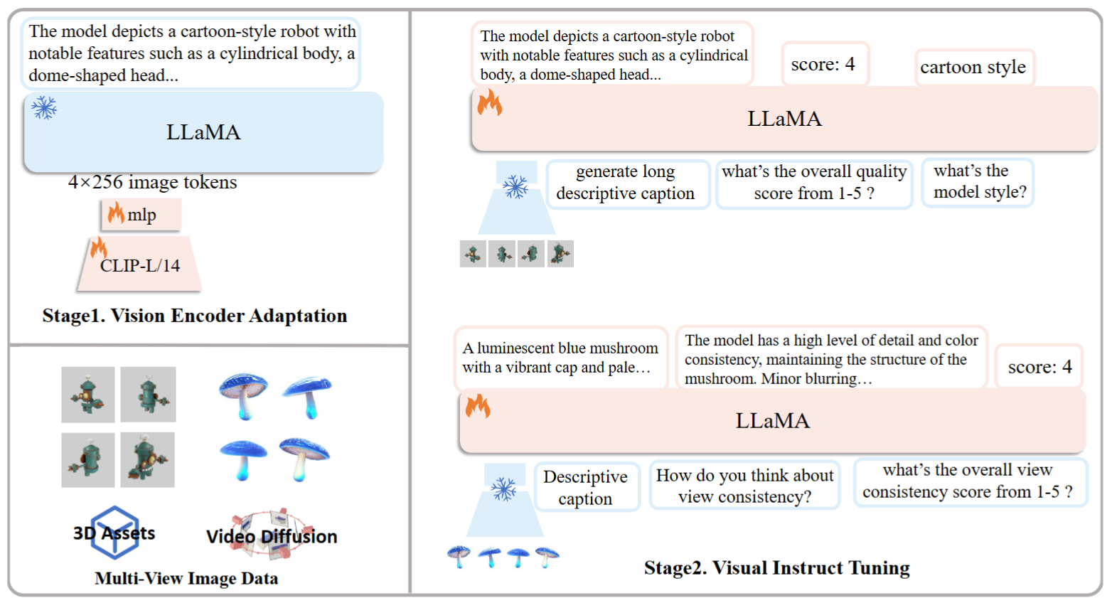
Methods [MV LLaVA]

Slide 7
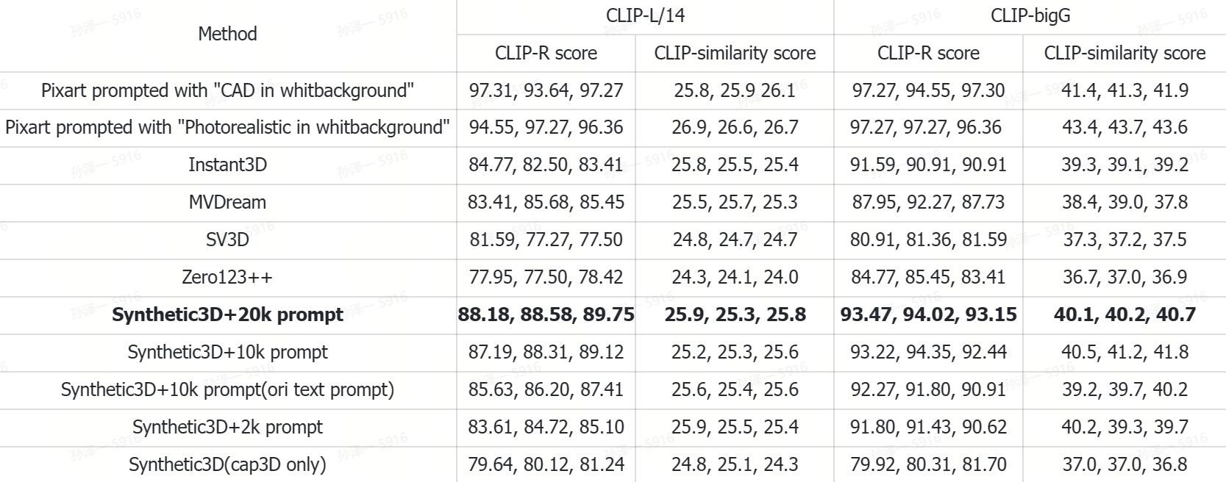
Experiments
GPT4 Evalualtion on 3D object generated by GRM (takes 4 view images as input and generate 3D gaussian)
 | Ours | Instant3D
text prompt alignment | 71 | 37
texture quality | 44 | 66
plausibility | 48 | 61

Slide 8
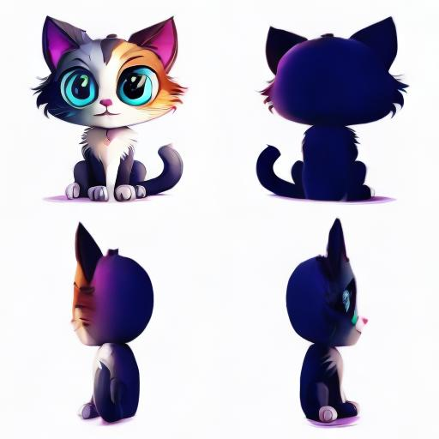
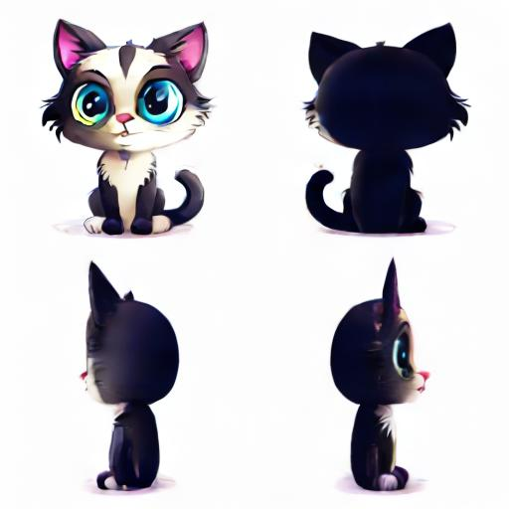
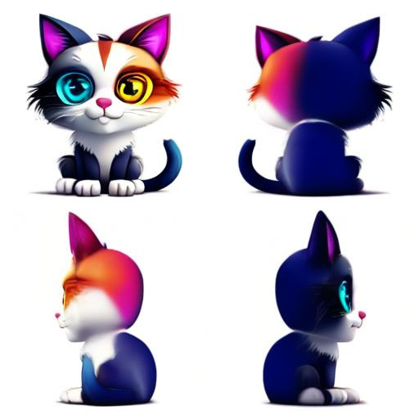
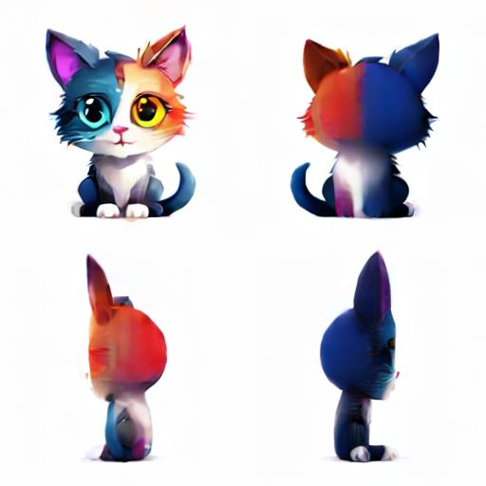
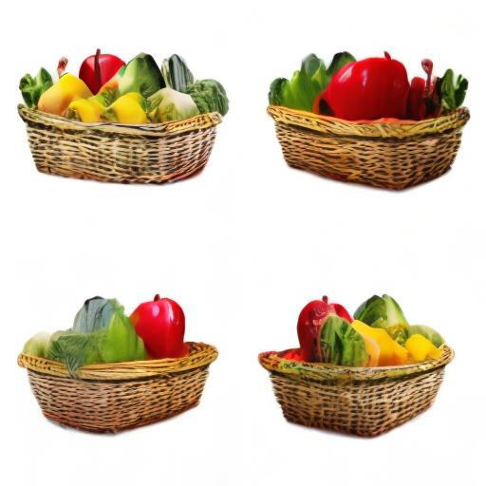
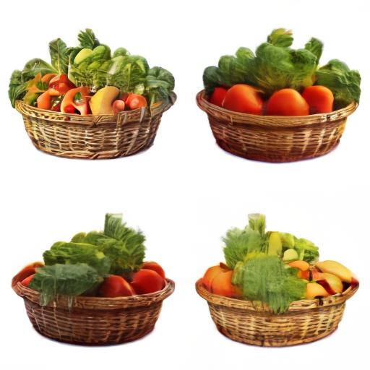
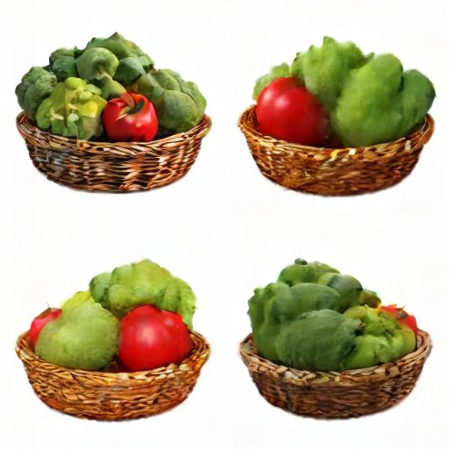
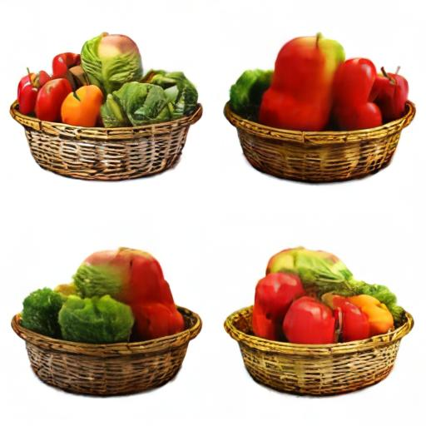
[Cartoon] A cat with two different colored eyes
400
300
200
100
[Photo-realistic] A collection of fresh vegetables arranged in a wicker basket

Slide 9
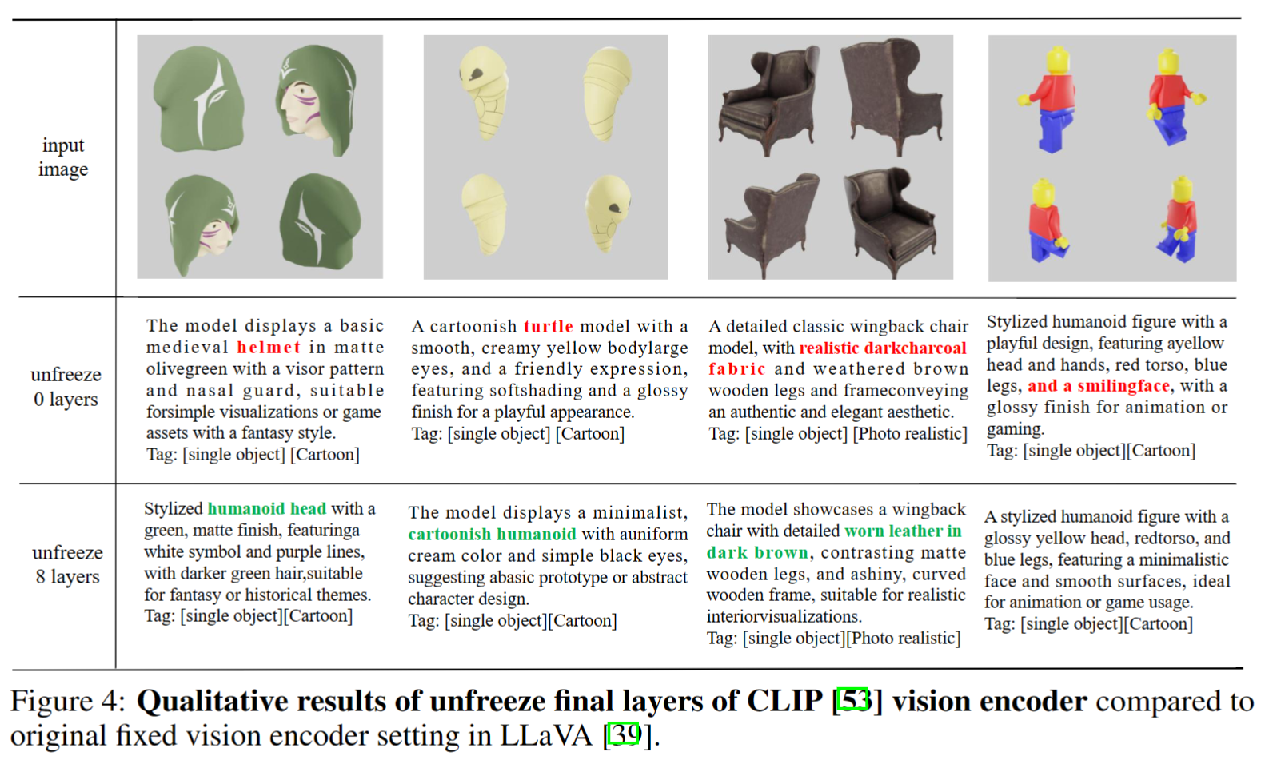
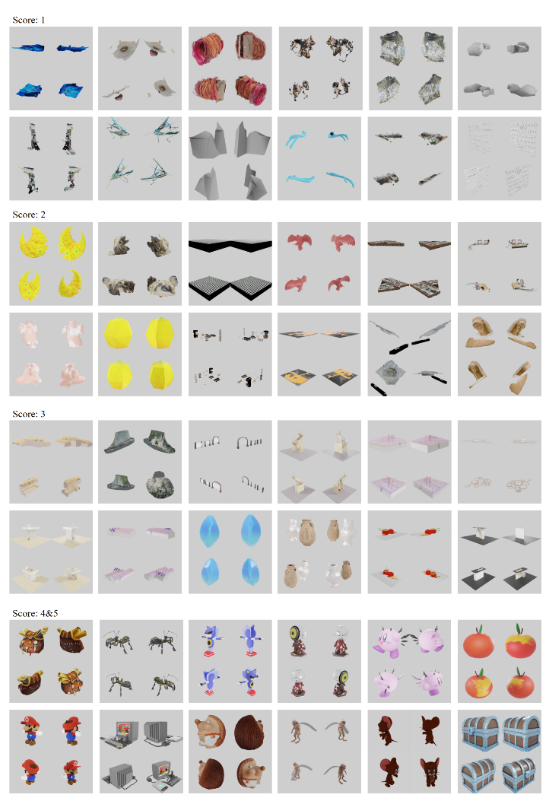
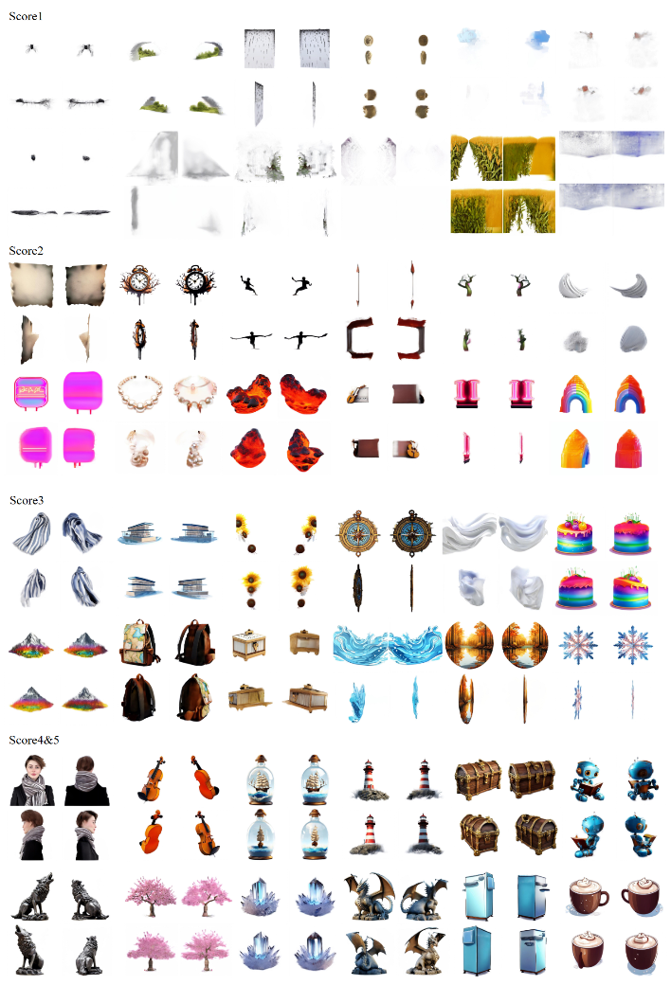
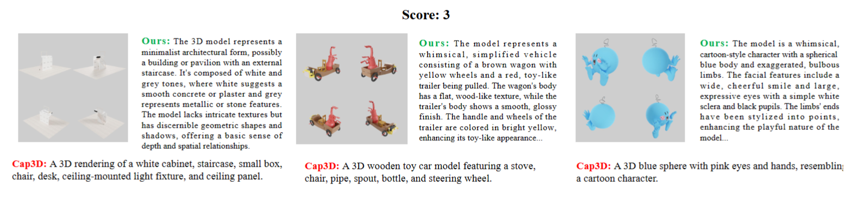

Slide 10
TODO

